Slide 1
6.1
The Relational Algebra

Slide 2
Relational Algebra

Slide 3
Chapter Outline
Relational Algebra
Unary Relational Operations
Relational Algebra Operations From Set Theory
Binary Relational Operations
Additional Relational Operations
Examples of Queries in Relational Algebra

Slide 4
Formal Relational Query Languages
Two mathematical Query Languages form the basis for “real” languages (e.g. SQL), and for implementation:
Relational Algebra:
More operational, very useful for representing execution plans.
Relational Calculus:
Lets users describe what they want, rather than how to compute it.
(Non-procedural, declarative.)

Slide 5
Relational Algebra Overview
Relational Algebra consists of several groups of operations
Unary Relational Operations
SELECT (symbol: σ (sigma))
PROJECT (symbol: π (pi))
RENAME (symbol: ρ (rho))
Relational Algebra Operations From Set Theory
UNION ( ∪ ), INTERSECTION ( ∩ ), DIFFERENCE (or MINUS, – )
CARTESIAN PRODUCT ( x )
Binary Relational Operations
JOIN (several variations of JOIN exist)
DIVISION
Additional Relational Operations
OUTER JOINS, OUTER UNION
AGGREGATE FUNCTIONS (These compute summary of information: for example, SUM, COUNT, AVG, MIN, MAX)

Slide 6
Unary Relational Operations: PROJECT
PROJECT Operation is denoted by π (pi)
This operation keeps certain columns (attributes) from a relation and discards the other columns.
PROJECT creates a vertical partitioning
The list of specified columns (attributes) is kept in each tuple. The other attributes in each tuple are discarded
Example:
To list each employee’s first and last name and salary, the following is used:
π_{LNAME, FNAME,SALARY}(EMPLOYEE)

Slide 7
Example Instances
Boats
bid
bname
color
101
Interlake
blue
102
Interlake
red
R1
103
Clipper
green
104
Marine
red
Reserves
Sailors
S1
S2

Slide 8
Projection (π)
Examples:
π_{age}(S2); π_{sname, rating}(S2);
Retains only attributes that are in the “projection list”.
Schema of result:
exactly the fields in the projection list, with the same names that they had in the input relation.
Projection operator has to eliminate duplicates (How do they arise? Why remove them?)
Note: real systems typically don’t do duplicate elimination unless the user explicitly asks for it. (Why not?)

Slide 9
Projection (π)
S2
Examples:
π_{age}(S2);
π_{sname, rating}(S2);
π_{age}(S2)
π_{sname, rating}(S2)
age
sname
rating
35.0
yuppy
9
55.5
lubber
8
35.0
guppy
5
35.0
rusty
10

Slide 10
Unary Relational Operations: SELECT
The SELECT operation (denoted by σ (sigma)) is used to select a subset of the tuples from a relation based on a selection condition.
The selection condition acts as a filter
Keeps only those tuples that satisfy the qualifying condition
Tuples satisfying the condition are selected whereas the other tuples are discarded (filtered out)
Examples:
Select the EMPLOYEE tuples whose department number is 4:
σ_{DNO = 4} (EMPLOYEE)
Select the employee tuples whose salary is greater than $30,000:
σ_{SALARY > 30,000} (EMPLOYEE)

Slide 11
Unary Relational Operations: SELECT (continued)
SELECT Operation Properties
The SELECT operation σ _{<selection condition>}(R) produces a relation S that has the same schema (same attributes) as R
SELECT σ is commutative:
σ _{<condition1>}(σ _{< condition2>} (R)) = σ _{<condition2>} (σ _{< condition1>} (R))
σ_{<cond1>}(σ_{<cond2>} (σ_{<cond3>} (R)) = σ_{<cond2>} (σ_{<cond3>} (σ_{<cond1>} ( R)))
A cascade of SELECT operations may be replaced by a single selection with a conjunction of all the conditions:
σ_{<cond1>}(σ_{< cond2>} (σ_{<cond3>}(R)) = σ <cond1> AND < cond2> AND < cond3>(R)))
The number of tuples in the result of a SELECT is less than (or equal to) the number of tuples in the input relation R

Slide 12
Example: Selection (σ)
Selects rows that satisfy selection condition.
Result is a relation.
Schema of result is same as that of the input relation.
Do we need to do duplicate elimination?
sid
sname
rating
age
28
yuppy
9
35.0
sname
rating
31
lubber
8
55.5
yuppy
9
44
guppy
5
35.0
58
rusty
10
35.0
rusty
10

Slide 13
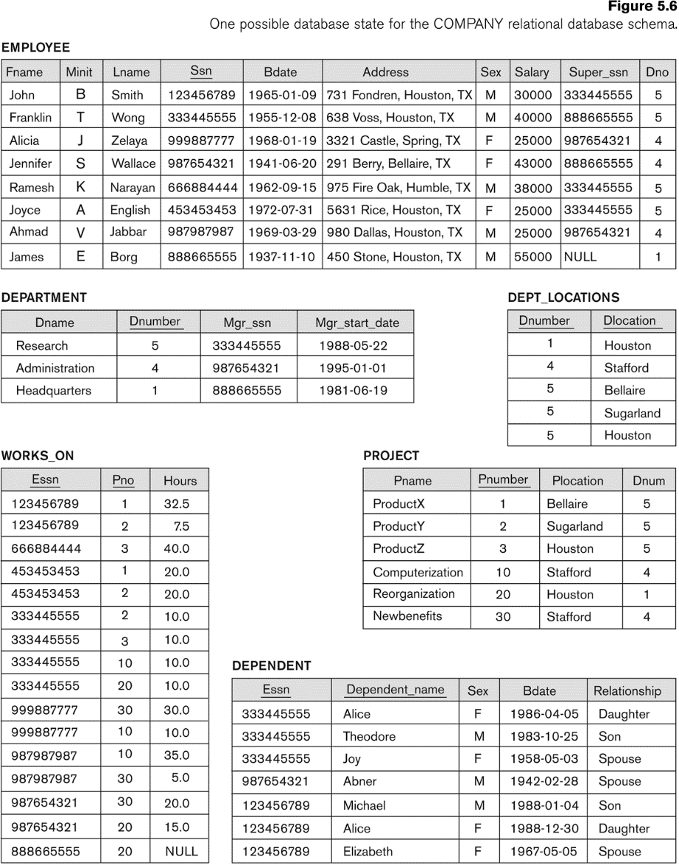
The following query results refer to this database state
Notes:
One possible database state for the company relational schema

Slide 14
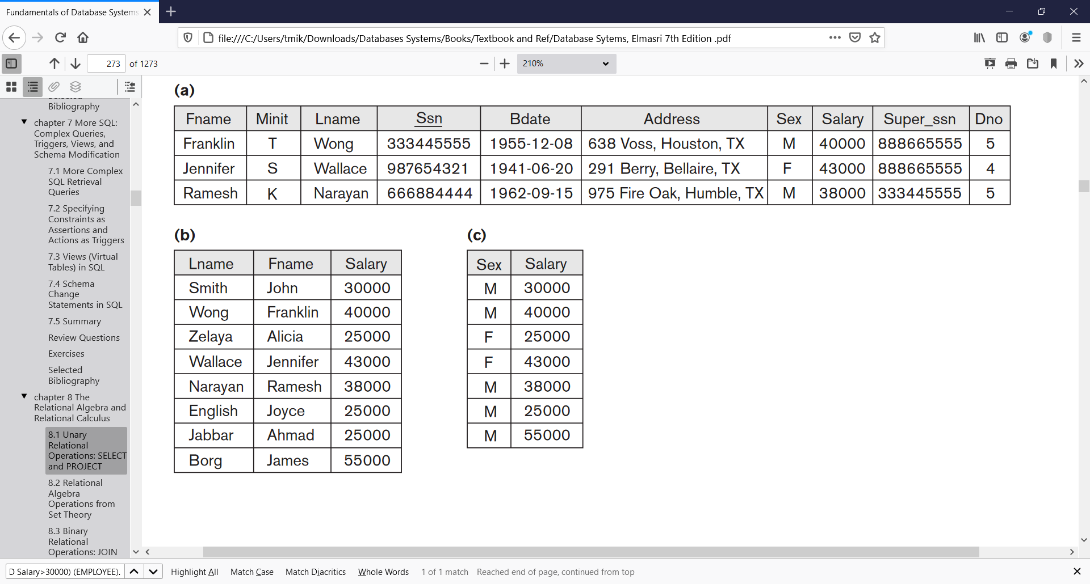
Example σ (Select)
σ((Dno=4 AND Salary>25000) OR (Dno=5 AND Salary>30000)) (EMPLOYEE).
Notes:
One possible database state for the company relational schema

Slide 15
Examples of applying PROJECT operations
(b) πLname, Fname, Salary(EMPLOYEE).
(c) πSex, Salary(EMPLOYEE).

Slide 16
Relational Algebra Expressions
We may want to apply several relational algebra operations one after the other
Either we can write the operations as a single relational algebra expression by nesting the operations, or
We can apply one operation at a time and create intermediate result relations.
In the latter case, we must give names to the relations that hold the intermediate results.

Slide 17
Single expression versus sequence of relational operations (Example)
To retrieve the first name, last name, and salary of all employees who work in department number 5, we must apply a select and a project operation
We can write a single relational algebra expression as follows:
π_{FNAME, LNAME, SALARY}(σ _{DNO=5}(EMPLOYEE))
OR We can explicitly show the sequence of operations, giving a name to each intermediate relation:
DEP5_EMPS ← σ _{DNO=5}(EMPLOYEE)
RESULT ← π _{FNAME, LNAME, SALARY} (DEP5_EMPS)

Slide 18
Unary Relational Operations: RENAME
The RENAME operator is denoted by ρ (rho)
In some cases, we may want to rename the attributes of a relation or the relation name or both
Useful when a query requires multiple operations
Necessary in some cases (JOIN operation)

Slide 19
Unary Relational Operations: RENAME
The general RENAME operation ρ can be expressed by any of the following forms:
ρ_{S (B1, B2, …, Bn )}(R) changes both:
the relation name to S, and
the column (attribute) names to B1, B1, …..Bn
ρ_{S}(R) changes:
the relation name only to S
ρ_{(B1, B2, …, Bn )}(R) changes:
the column (attribute) names only to B1, B1, …..Bn

Slide 20
Unary Relational Operations: RENAME
For convenience, we also use a shorthand for renaming attributes in an intermediate relation:
If we write:
RESULT ← π _{FNAME, LNAME, SALARY} (DEP5_EMPS)
RESULT will have the same attribute names as DEP5_EMPS (same attributes as EMPLOYEE)
If we write:
RESULT(F, M, L, S, B, DNO)← ρ_{RESULT (F, M, L,} _{S,} _{B, DNO)} (DEP5_EMPS)
Six(6) attributes of DEP5_EMPS are renamed to F, M, L, S, B, DNO.
Note: the ← symbol is an assignment operator

Slide 21
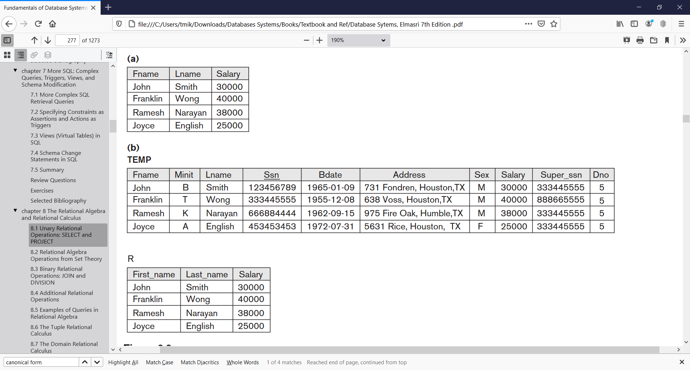
Example of applying multiple operations and RENAME
Results of a sequence of operations. (a) π_{Fname, Lname, Salary} (σ_{Dno=5}(EMPLOYEE)). (b) TEMP ←σ_{Dno=5}(EMPLOYEE)
(c) R(First_name, Last_name, Salary)←π_{Fname, Lname, Salary}(TEMP)

Slide 22
Relational Algebra Operations from Set Theory: UNION
UNION Operation
Binary operation, denoted by ∪
The result of R ∪ S, is a relation that includes all tuples that are either in R or in S or in both R and S
Duplicate tuples are eliminated
The two operand relations R and S must be “type compatible” (or UNION compatible)
R and S must have same number of attributes
Each pair of corresponding attributes must be type compatible (have same or compatible domains)

Slide 23
Relational Algebra Operations from Set Theory: UNION
Example:
To retrieve the social security numbers of all employees who either work in department 5 or directly supervise an employee who works in department 5
We can use the UNION operation as follows:
DEP5_EMPS ← σ_{DNO=5} (EMPLOYEE)
RESULT1 ← π _{SSN}(DEP5_EMPS)
RESULT2(SSN) ← π_{SUPERSSN}(DEP5_EMPS)
RESULT ← RESULT1 ∪ RESULT2
The union operation produces the tuples that are in either RESULT1 or RESULT2 or both

Slide 24
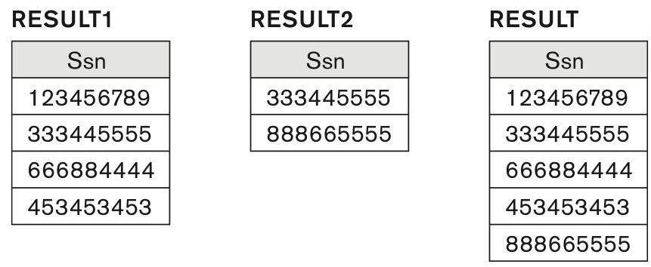
Result of the UNION operation RESULT ← RESULT1 ∪ RESULT2.
DEP5_EMPS ← σ_{DNO=5} (EMPLOYEE)
RESULT1 ← π _{SSN}(DEP5_EMPS)
RESULT2(SSN) ← π_{SUPERSSN}(DEP5_EMPS)
RESULT ← RESULT1 ∪ RESULT2

Slide 25
Relational Algebra Operations from Set Theory: INTERSECTION
INTERSECTION is denoted by ∩
The result of the operation R ∩ S, is a relation that includes all tuples that are in both R and S
The attribute names in the result will be the same as the attribute names in R
The two operand relations R and S must be “type compatible”

Slide 26
Relational Algebra Operations from Set Theory: SET DIFFERENCE (cont.)
SET DIFFERENCE (also called MINUS or EXCEPT) is denoted by –
The result of R – S, is a relation that includes all tuples that are in R but not in S
The attribute names in the result will be the same as the attribute names in R
The two operand relations R and S must be “type compatible”

Slide 27
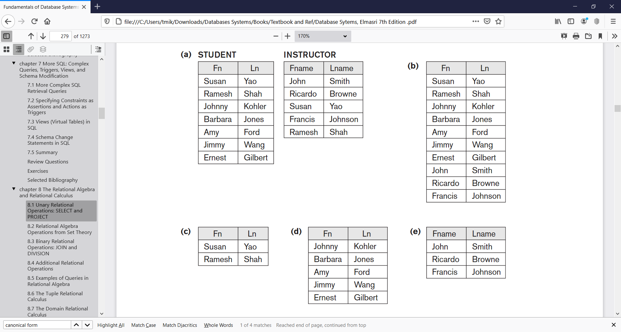
Example to illustrate the result of UNION, INTERSECT, and DIFFERENCE
(a) Two union-compatible relations.
(b) STUDENT ∪ INSTRUCTOR. (c) STUDENT ∩ INSTRUCTOR. (d) STUDENT – INSTRUCTOR. (e) INSTRUCTOR – STUDENT.
Notes:
The set operations UNION, INTERSECTION, and MINUS. (a) Two union-compatible relations. (b) STUDENT ∪ INSTRUCTOR. (c) STUDENT ∩ INSTRUCTOR. (d) STUDENT – INSTRUCTOR. (e) INSTRUCTOR – STUDENT.

Slide 28
Some properties of UNION, INTERSECT, and DIFFERENCE
Notice that both union and intersection are commutative operations; that is
R ∪ S = S ∪ R, and R ∩ S = S ∩ R
Both union and intersection can be treated as n-ary operations applicable to any number of relations as both are associative operations; that is
R ∪ (S ∪ T) = (R ∪ S) ∪ T
(R ∩ S) ∩ T = R ∩ (S ∩ T)
The minus operation is not commutative; that is, in general
R – S ≠ S – R

Slide 29
Union and Set-Difference
Both of these operations take two input relations, which must be
union-compatible:
Same number of fields.
‘Corresponding’ fields have the same type.

Slide 30
Union
S1
S2

Slide 31
Set Difference
S1
S2
S2 – S1

Slide 32
Compound Operator: Intersection
In addition to the 5 basic operators, there are several additional “Compound Operators”
These add no computational power to the language, but are useful shorthands.
Can be expressed solely with the basic ops.
Intersection takes two input relations, which must be union-compatible.
Q: How to express it using basic operators?
R ∩ S = R − (R − S)

Slide 33
Intersection
S1
S2

Slide 34
Relational Algebra Operations from Set Theory: CARTESIAN PRODUCT
CARTESIAN (or CROSS) PRODUCT Operation
Denoted by R(A1, A2, . . ., An) x S(B1, B2, . . ., Bm)
Result is a relation Q with degree n + m attributes:
Q(A1, A2, . . ., An, B1, B2, . . ., Bm), in that order.
The resulting relation state has one tuple for each combination of tuples
one from R and one from S.
Hence, if R has N_{R} tuples (denoted as |R| = N_{R} ), and S has N_{S} tuples, then R x S will have N_{R} * N_{S} tuples.
The two operands do NOT have to be "type compatible”
Notes:
This operation is used to combine tuples from two relations in a combinatorial fashion.

Slide 35
Cross-Product
S1 × R1:
Each row of S1 paired with each row of R1.
Q: How many rows in the result?
Result schema has one field per field of S1 and R1, with field names ‘inherited’ if possible.
May have a naming conflict:
Both S1 and R1 have a field with the same name.
In this case, can use the renaming operator:

Slide 36
Cross Product Example
R1
S1
S1 x R1 =

Slide 37
Binary Relational Operations: JOIN
JOIN Operation (denoted by ⋈ )
This operation is very important for any relational database with more than a single relation, because it allows us combine related tuples from various relations
The general form of a join operation on two relations R(A1, A2, . . ., An) and S(B1, B2, . . ., Bm) is:
R ⋈_{<join condition>}S
where R and S can be any relations that result from general relational algebra expressions.

Slide 38
Binary Relational Operations : NATURAL JOIN
Joins are compound operators involving cross product, selection, and (sometimes) projection.
Most common type of join is a “natural join” (often just called “join”). R ⋈ S conceptually is:
Compute R × S
Select rows where attributes that appear in both relations have equal values
Project all unique attributes and one copy of each of the common ones.
Note: Usually done much more efficiently than this.

Slide 39
Binary Relational Operations NATURAL JOIN (continued)
Example: To apply a natural join on the DNUMBER attributes of DEPARTMENT and DEPT_LOCATIONS, it is sufficient to write:
DEPT_LOCS ← DEPARTMENT * DEPT_LOCATIONS
Only attribute with the same name is DNUMBER
An implicit join condition is created based on this attribute:
DEPARTMENT.DNUMBER=DEPT_LOCATIONS.DNUMBER
Another example: Q ← R(A,B,C,D) * S(C,D,E)
The implicit join condition includes each pair of attributes with the same name, “AND”ed together:
R.C=S.C AND R.D.S.D
Result keeps only one attribute of each such pair:
Q(A,B,C,D,E)

Slide 40
Natural Join Example
R1
S1
S1⋈ R1

Slide 41
θ-Join and Equijoin
Condition Join (or “(theta)-join”):
R ⋈_{θ} S = σ_{θ}(R × S) or
R ⋈_{C} S = σ_{C}(R × S)
Result schema same as that of cross-product.
May have fewer tuples than cross-product.
Equi-Join:
Special case: condition c contains only conjunction of equalities.

Slide 42
Binary Relational Operations: EQUIJOIN
EQUIJOIN Operation
The most common use of join involves join conditions with equality comparisons only
Such a join, where the only comparison operator used is =, is called an EQUIJOIN.
In the result of an EQUIJOIN we always have one or more pairs of attributes (whose names need not be identical) that have identical values in every tuple.

Slide 43
Example
Car
Boat
CarModel | CarPrice
CarA | 20,000
CarB | 30,000
CarC | 50,000
BoatModel | BoatPrice
Boat1 | 10,000
Boat2 | 40,000
Boat3 | 60,000
Suppose a customer wants to buy a car and a boat, but he/she does not want to spend more money for the boat than for the car.
The θ-join (⋈_{θ}) on the predicate CarPrice ≥ BoatPrice produces the flattened pairs of rows which satisfy the predicate.
Car ⋈ Boat
CarPrice ≥ BoatPrice
CarModel | CarPrice | BoatModel | BoatPrice
CarA | 20,000 | Boat1 | 10,000
CarB | 30,000 | Boat1 | 10,000
CarC | 50,000 | Boat1 | 10,000
CarC | 50,000 | Boat2 | 40,000

Slide 44
Example 2
R1
S1
S1 ⋈_{S1.sid} _{< R1.sid} R1
(
sid)
sname
rating
age
(
sid)
bid
day
22
dustin
7
45.0
58
103
11/12/96
31
lubber
8
55.5
58
103
11/12/96
Result schema same as that of cross-product.
May have fewer tuples than cross-product.
In case the operator θ is the equality operator (=) then this join is also called an equijoin.

Slide 45
Semijoin (⋉)(⋊)
The left semijoin is a joining similar to the natural join and written as R ⋉ S.
The result is the set of all tuples in R for which there is a tuple in S that is equal on their common attribute names.
The difference from a natural join is that other columns of S do not appear. For example, consider the tables Employee and Dept and their semijoin:
Employee
Name | EmpId | DeptName
Harry | 3415 | Finance
Sally | 2241 | Sales
George | 3401 | Finance
Harriet | 2202 | Production
Dept
DeptName | Manager
Sales | Sally
Production | Harriet
Employee ⋉ Dept
Name | EmpId | DeptName
Sally | 2241 | Sales
Harriet | 2202 | Production

Slide 46
Semijoin (⋉)(⋊)
The left semijoin is a joining similar to the natural join and written as R ⋉ S.
The result is the set of all tuples in R for which there is a tuple in S that is equal on their common attribute names.
The difference from a natural join is that other columns of S do not appear. For example, consider the tables Employee and Dept and their semijoin:
Employee
Name | EmpId | DeptName
Harry | 3415 | Finance
Sally | 2241 | Sales
George | 3401 | Finance
Harriet | 2202 | Production
Dept
DeptName | Manager
Sales | Sally
Production | Harriet
Employee ⋉ Dept
Name | EmpId | DeptName
Sally | 2241 | Sales
Harriet | 2202 | Production

Slide 47
Antijoin (▷)
The antijoin, written as R ▷ S, is similar to the semijoin, but the result of an antijoin is only those tuples in R for which there is no tuple in S that is equal on their common attribute names
Employee
Name | EmpId | DeptName
Harry | 3415 | Finance
Sally | 2241 | Sales
George | 3401 | Finance
Harriet | 2202 | Production
Dept
DeptName | Manager
Sales | Sally
Production | Harriet
Employee ▷ Dept
Name | EmpId | DeptName
Harry | 3415 | Finance
George | 3401 | Finance

Slide 48
Binary Relational Operations: DIVISION
Completed
Student | Task
Fred | Database1
Fred | Database2
Fred | Compiler1
Eugene | Database1
Eugene | Compiler1
Sarah | Database1
Sarah | Database2
The division is a binary operation that is written as R ÷ S. Division is not implemented directly in SQL.
For a tuple t to appear in the result T of the DIVISION, the values in t must appear in R in combination with every tuple in S.
DBProject
Task
Database1
Database2
The result of the division above contains exactly the students who have completed both of the tasks in the Database project.
Completed ÷ DBProject
Student
Fred
Sarah

Slide 49
Simulation of Division (÷)
1
T := π_{Student}(R) × S
2
U := T − π_{Student,Task}(R)
T
Student | Task
Fred | Database1
Fred | Database2
Eugene | Database1
Eugene | Database2
Sarah | Database1
Sarah | Database2
Completed
Student | Task
Fred | Database1
Fred | Database2
Fred | Compiler1
Eugene | Database1
Eugene | Compiler1
Sarah | Database1
Sarah | Database2
U aka T − R | Task
Eugene | Database2
3
V := π_{Student}(U)
V
Student
Eugene
4
W := π_{Student}(R) − V.
W
Student
Fred
Sarah
π_{Student}(R)
Student
Fred
Eugene
Sarah
V
Student
Eugene
DBProject
Task
Database1
Database2
Desired Result
Notes:
EG: First, let's pretend that "Completed" has a third attribute called "grade". It's unwanted baggage here, so we must project it off always. In fact in this step we can drop 'Task' from R as well; the multiply puts it back on.
T := π_{Student}(R) × S // This gives us every possible desired combination, including those that don't actually exist in R, and excluding others (eg Fred | compiler1, which is not a desired combination)

Slide 50
Outer joins
Outer join contains those tuples and additionally some tuples formed by extending an unmatched tuple in one of the operands by "fill" values for each of the attributes of the other operand.
a null value, ω, to be used for the fill values; in practice this corresponds to the NULL in SQL.
Three outer join operators are defined:
⟕ left outer join,
⟖ right outer join, and
⟗ full outer join.
The word "outer" is sometimes omitted.

Slide 51
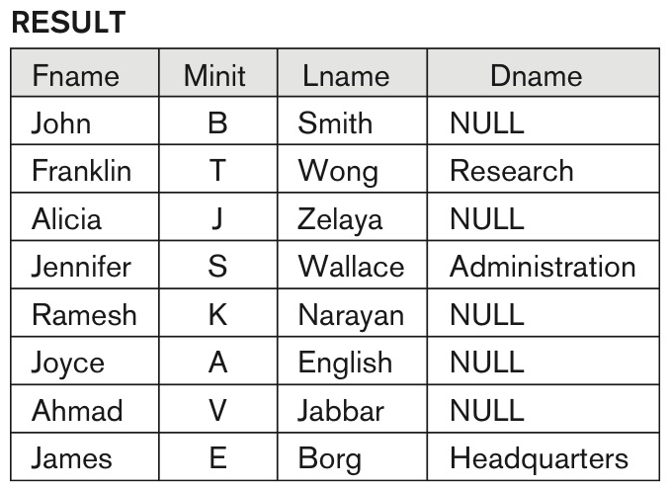
The result of a LEFT OUTER JOIN operation.
EMPLOYEE ⟕ DEPARTMENT

Slide 52
Left outer join (⟕)
The left outer join is written as R ⟕ S .
The result of the left outer join is the set of all combinations of tuples in R and S that are equal on their common attribute names, in addition (loosely speaking) to tuples in R that have no matching tuples in S.
Dept
DeptName | Manager
Sales | Harriet
Production | Charles
Employee ⟕ Dept
Name | EmpId | DeptName | Manager
Harry | 3415 | Finance | ω
Sally | 2241 | Sales | Harriet
George | 3401 | Finance | ω
Harriet | 2202 | Sales | Harriet
Tim | 1123 | Executive | ω
Employee
Name | EmpId | DeptName
Harry | 3415 | Finance
Sally | 2241 | Sales
George | 3401 | Finance
Harriet | 2202 | Sales
Tim | 1123 | Executive
Notes:
In the resulting relation, tuples in S which have no common values in common attribute names with tuples in R take a null value, ω.

Slide 53
Right outer join (⟖)
The right outer join of relations R and S is written as R ⟖ S.
The result of the right outer join is the set of all combinations of tuples in R and S that are equal on their common attribute names, in addition to tuples in S that have no matching tuples in R.
Dept
DeptName | Manager
Sales | Harriet
Production | Charles
Employee ⟖ Dept
Name | EmpId | DeptName | Manager
Sally | 2241 | Sales | Harriet
Harriet | 2202 | Sales | Harriet
ω | ω | Production | Charles
Employee
Name | EmpId | DeptName
Harry | 3415 | Finance
Sally | 2241 | Sales
George | 3401 | Finance
Harriet | 2202 | Sales
Tim | 1123 | Executive

Slide 54
Full outer join (⟗)
The full outer join is written as R ⟗ S.
The result of the full outer join is the set of all combinations of tuples in R and S that are equal on their common attribute names, in addition to tuples in S that have no matching tuples in R and tuples in R that have no matching tuples in S in their common attribute names.
Dept
DeptName | Manager
Sales | Harriet
Production | Charles
Employee ⟗ Dept
Name | EmpId | DeptName | Manager
Harry | 3415 | Finance | ω
Sally | 2241 | Sales | Harriet
George | 3401 | Finance | ω
Harriet | 2202 | Sales | Harriet
Tim | 1123 | Executive | ω
ω | ω | Production | Charles
Employee
Name | EmpId | DeptName
Harry | 3415 | Finance
Sally | 2241 | Sales
George | 3401 | Finance
Harriet | 2202 | Sales
Tim | 1123 | Executive
Notes:
For an example consider the tables Employee and Dept and their full outer join:

Slide 55
Examples
Sailors
sid
sname
rating
age
22
dustin
7
45.0
Boats
bid
bname
color
31
lubber
8
55.5
101
Interlake
Blue
58
rusty
10
35.0
102
Interlake
Red
Reserves
103
Clipper
Green
104
Marine
Red
Find names of sailors who’ve reserved boat #103
Solution 1: π_{sname}((σ_{bid=103}Reserves) ⋈ Sailors)
Solution 2: π_{sname}(σ_{bid=103}(Reserves ⋈ Sailors)

Slide 56
Examples
Sailors
sid
sname
rating
age
22
dustin
7
45.0
Boats
bid
bname
color
31
lubber
8
55.5
101
Interlake
Blue
58
rusty
10
35.0
102
Interlake
Red
Reserves
103
Clipper
Green
104
Marine
Red
Find names of sailors who’ve reserved a red boat
Solution 1:
π_{sname}((σ_{color=‘red’}Boats) ⋈ Reserves ⋈ Sailors)
Solution 2:
π_{sname}(π_{sid}((π_{bid}σ_{color=‘red’}Boats) ⋈ Reserves) ⋈ Sailors)
Notes:
Information about boat color only available in Boats; so need an extra join

Slide 57
Examples
sid
sname
rating
age
Sailors
Boats
22
dustin
7
45.0
bid
bname
color
31
lubber
8
55.5
101
Interlake
Blue
58
rusty
10
35.0
102
Interlake
Red
103
Clipper
Green
Reserves
104
Marine
Red
To find sailors who’ve reserved all ‘Interlake’ boat
Solution 1:
π_{sname}((σ_{bname=‘Interlake’}Boats) ⋈ Reserves ⋈ Sailors
Solution 2:
π_{sname}(π_{sid}((π_{bid}σ_{bname=‘Interlake’}Boats) ⋈ Reserves) ⋈ Sailors)
Notes:
Can identify all red or green boats, then find sailors who’ve reserved one of these boats

Slide 58
Examples
Sailors
sid
sname
rating
age
Boats
22
dustin
7
45.0
bid
bname
color
101
Interlake
Blue
31
lubber
8
55.5
102
Interlake
Red
58
rusty
10
35.0
103
Clipper
Green
Reserves
104
Marine
Red
Find sailors who’ve reserved a red boat or a green boat
Solution:
Tempboats ←(σ_{color=‘red’} ∨_{color=‘green’} Boats) π_{sname}(Tempboats ⋈ Reserves ⋈ Sailors)
Notes:
Can identify all red or green boats, then find sailors who’ve reserved one of these boats

Slide 59
Find sailors who’ve reserved a red and a green boat
Cut-and-paste previous slide?
Solution:
Tempboats ←(σ_{color=‘red’ ∧} _{color=‘green’} Boats)
(π_{sname}(Tempboats ⋈ Reserves ⋈ Sailors)
Notes:
approach won’t work! Must identify sailors who’ve reserved red boats, sailors who’ve reserved green boats, then find the intersection

Slide 60
Examples
sid
sname
rating
age
Sailors
Boats
22
dustin
7
45.0
bid
bname
color
31
lubber
8
55.5
101
Interlake
Blue
58
rusty
10
35.0
102
Interlake
Red
103
Clipper
Green
Reserves
104
Marine
Red
Find sailors who’ve reserved a red boat and a green boat
Solution:
Tempred ←(πsid(σ_{color=‘red’} Boats) ⋈ Reserves) Tempgreen ←(πsid((σ_{color=‘green’} Boats) ⋈ Reserves) π_{sname}((Tempred ∩ Tempgreen) ⋈ Sailors)
Notes:
Can identify all red or green boats, then find sailors who’ve reserved one of these boats

Slide 61
Examples
sid
sname
rating
age
Sailors
Boats
22
dustin
7
45.0
bid
bname
color
31
lubber
8
55.5
101
Interlake
Blue
58
rusty
10
35.0
102
Interlake
Red
103
Clipper
Green
Reserves
104
Marine
Red
Find the names of sailors who’ve reserved all boats
Solution:
Tempsid ←π_{sid,bid}Reserves÷ π_{bid}Boats
π_{sname}(Tempsid⋈ Sailors)
Notes:
Can identify all red or green boats, then find sailors who’ve reserved one of these boats

Slide 62
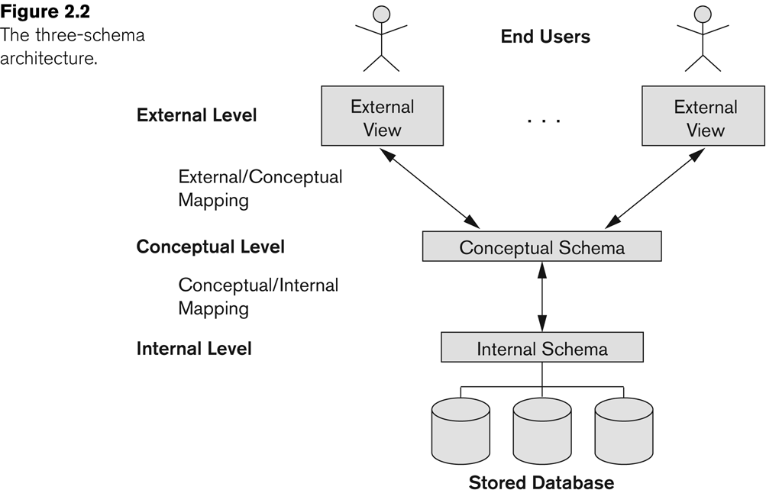
Three-Schema(ANSI-SPARC) Architecture
Notes:
(American National Standards Institute/ Standards Planning And Requirements Committee) architecture, after the committee that proposed it (Tsichritzis & Klug, 1978).

Slide 63
Complete Set of Relational Operations
The set of operations including SELECT σ, PROJECT π , UNION ∪, DIFFERENCE − , RENAME ρ, and CARTESIAN PRODUCT X is called a complete set because any other relational algebra expression can be expressed by a combination of these five operations.
For example:
R ∩ S = (R ∪ S ) – ((R − S) ∪ (S − R))
R ⋈_{<join condition>}S = σ _{<join condition>} (R X S)

Slide 64
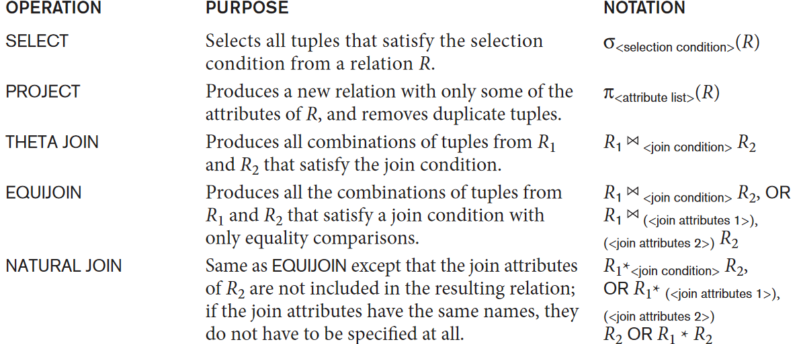
Operations of Relational Algebra
continued on next slide

Slide 65
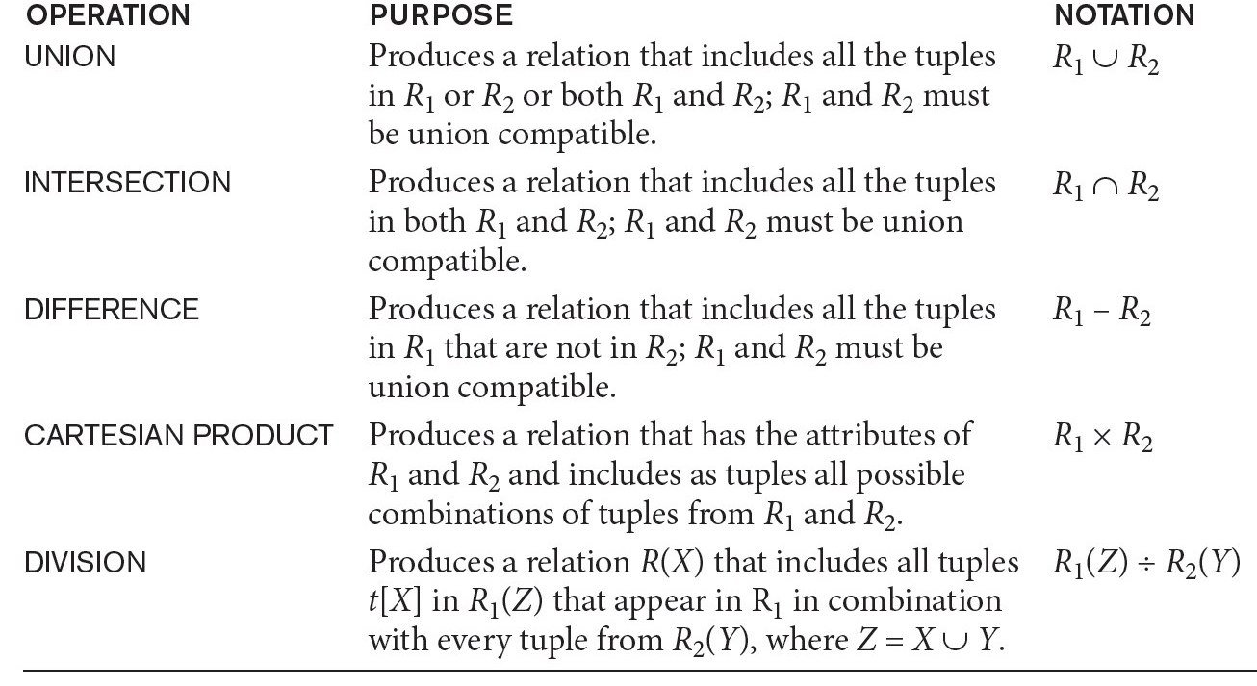
Operations of Relational Algebra (continued)

Slide 66
Review on Relational Algebra
With Exercises on University Database

Slide 67
University Schema
classroom (building, room_number, capacity);
department (dept_name, building, budget);
course(course_id, title, dept_name , credits);
instructor(ID, name, dept_name , salary)
section (course_id , sec_id , semester, year, building, room_number, time_slot_id);
teaches(ID, course_id , sec_id , semester , year);
student(ID, name , dept_name , tot_cred);
takes(ID, course_id , sec_id , semester , year, grade);
advisor(s_ID, i_ID );
time_slot(time_slot_id , day, start_hr, start_min, end_hr , end_min);
prereq(course_id , prereq_id );

Slide 68
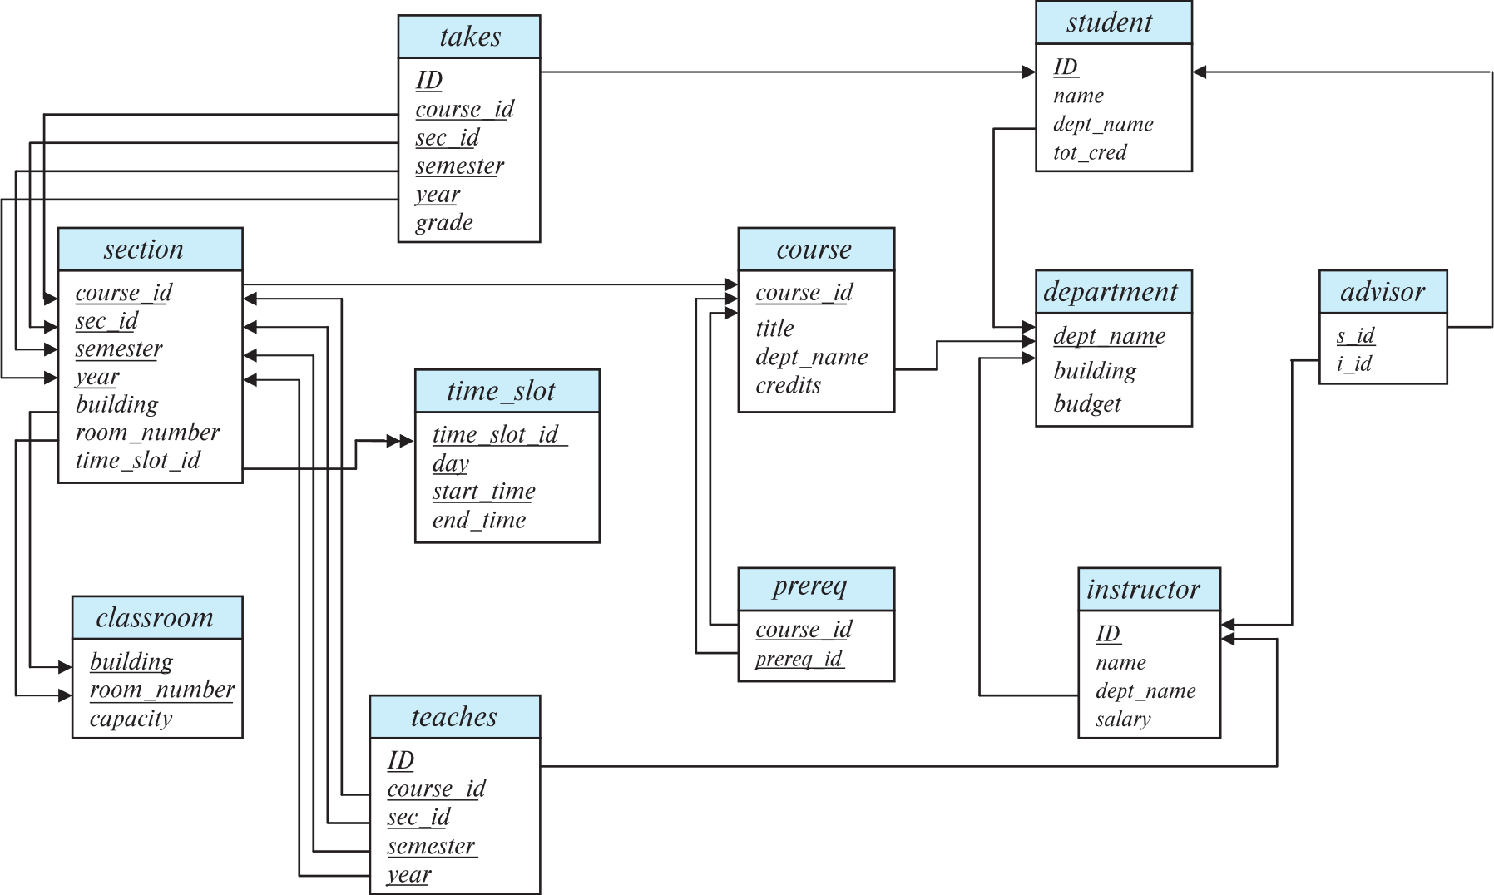
Schema Diagram for University Database

Slide 69
Relational Query Languages
Procedural versus non-procedural, or declarative
“Pure” languages:
Relational algebra
Tuple relational calculus
Domain relational calculus
We will concentrate in this review on relational algebra
Consists of 6 basic operations
Notes:
The 3 pure languages are equivalent in computing power

Slide 70
Relational Algebra
A procedural language consisting of a set of operations that take one or two relations as input and produce a new relation as their result.
Six basic operators
select: σ
project: ∏
union: ∪
set difference: –
Cartesian product: x
rename: ρ
Notes:
R ∩ S = R − (R − S)
R ∩ S = (R Υ S ) – ((R − S) Υ (S − R))
R ⋈_{<join condition>}S = σ_{join condition>} (R X S)

Slide 71
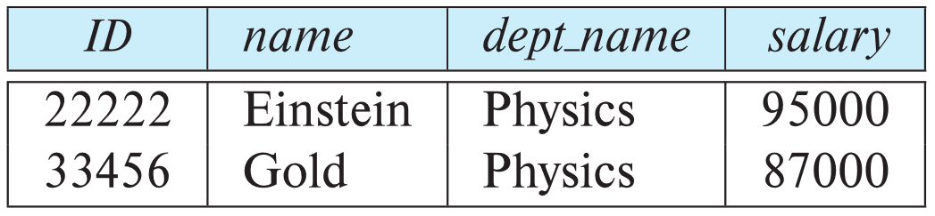
Select Operation
The select operation selects tuples that satisfy a given predicate.
Notation: σ _{p(r)}
p is called the selection predicate
Example: Select those tuples of the instructor relation where the instructor is in the “Physics” department.
Query: σ _{dept_name=“Physics”} (instructor)
Result

Slide 72
Select Operation (Cont.)
We allow comparisons using =, ≠, >, ≥. <. ≤ in the selection predicate.
We can combine several predicates into a larger predicate by using the connectives:
∧ (and), ∨ (or), ¬ (not)
Example: Find the instructors in Physics with a salary greater $90,000, we write:
σ _{dept_name=“Physics”} ∧ _{salary >} _{90,000} (instructor)
The select predicate may include comparisons between two attributes.
Example, find all departments whose name is the same as their building name:
σ _{dept_name=building} (department)

Slide 73
Project Operation
A unary operation that returns its argument relation, with certain attributes left out.
Notation:
∏ _{A1,A2,A3 ….Ak} (r)
where A₁, A₂, …, A_{k} are attribute names and r is a relation name.
The result is defined as the relation of k columns obtained by erasing the columns that are not listed
Duplicate rows removed from result, since relations are sets

Slide 74
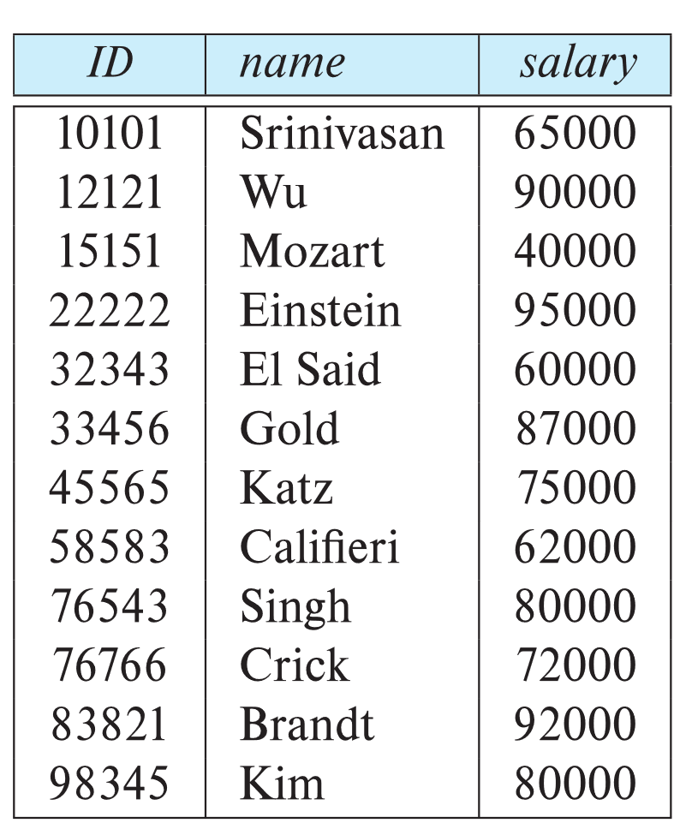
Project Operation Example
Instructor(ID, name, dept_name , salary)
Example: Eliminate the dept_name attribute of instructor
Query: ∏_{ID, name, salary} (instructor)
Result:

Slide 75
Composition of Relational Operations
The result of a relational-algebra operation is relation and therefore of relational-algebra operations can be composed together into a relational-algebra expression.
Consider the query -- Find the names of all instructors in the Physics department.
∏_{name}(σ _{dept_name} _{=“Physics”} (instructor))
Instead of giving the name of a relation as the argument of the projection operation, we give an expression that evaluates to a relation.

Slide 76
Cartesian-Product Operation
The Cartesian-product operation (denoted by X) allows us to combine information from any two relations.
Example: the Cartesian product of the relations instructor and teaches is written as:
instructor X teaches
We construct a tuple of the result out of each possible pair of tuples: one from the instructor relation and one from the teaches relation (see next slide)
Since the instructor ID appears in both relations we distinguish between these attribute by attaching to the attribute the name of the relation from which the attribute originally came.
instructor.ID
teaches.ID
instructor(ID, name, dept_name , salary)
teaches(ID, course_id , sec_id , semester , year);

Slide 77
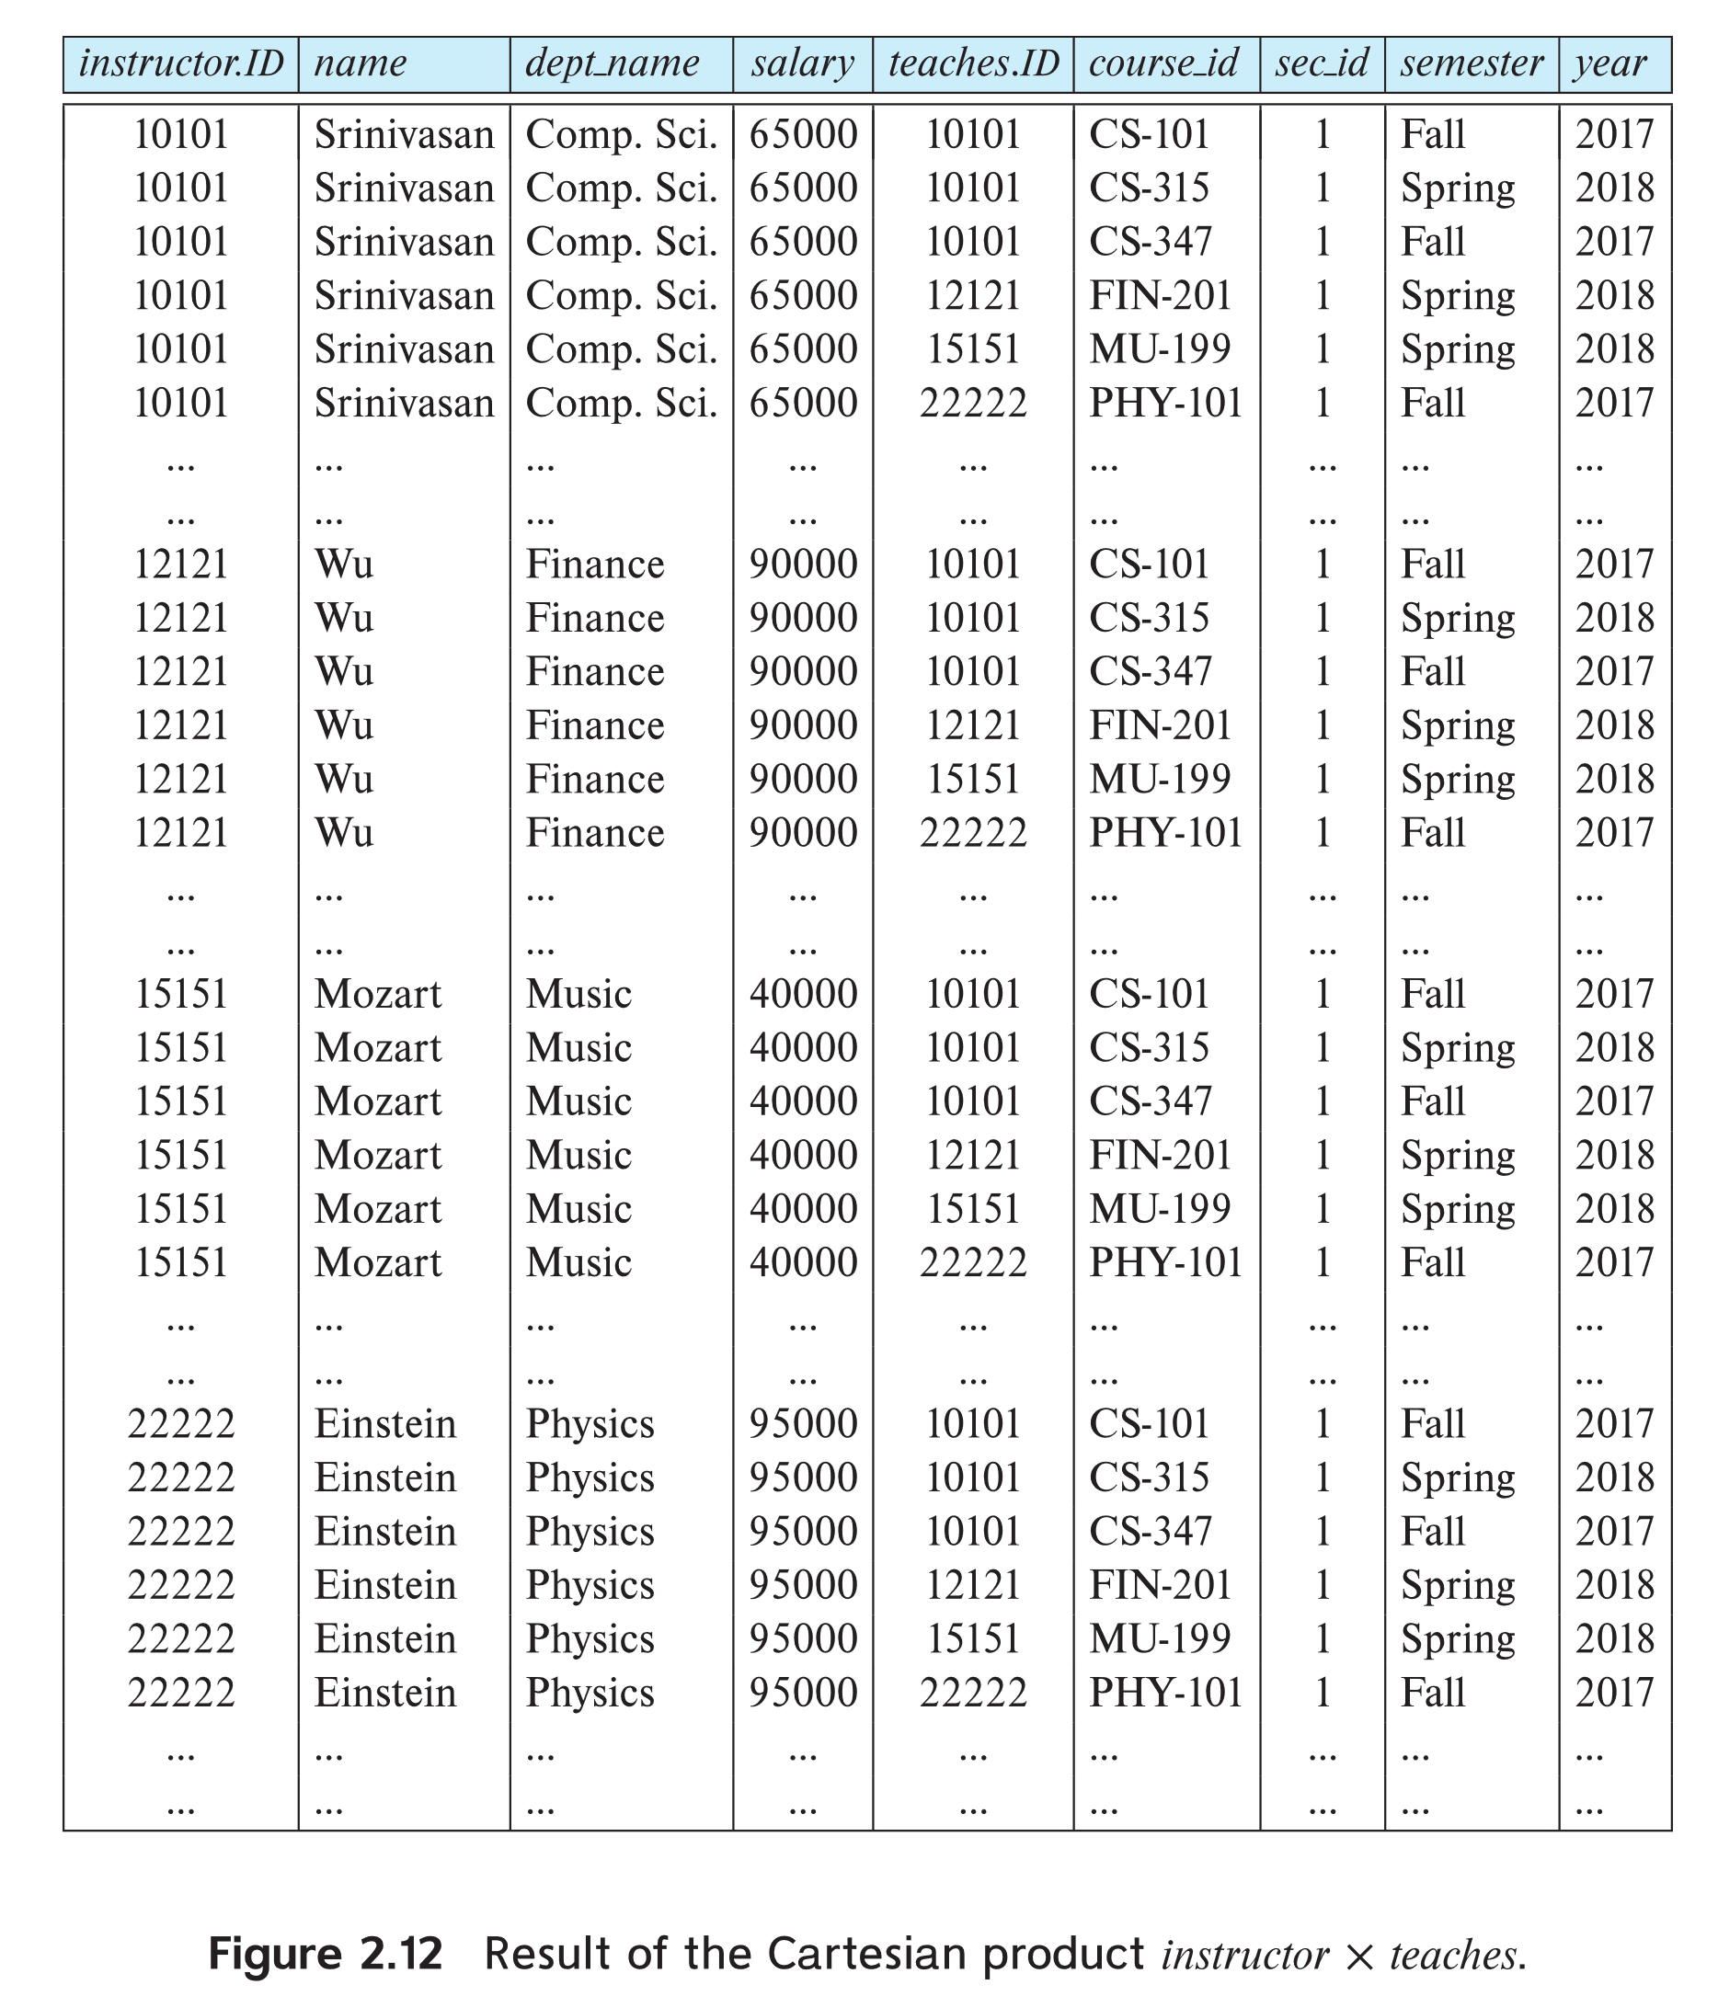
instructor X teaches

Slide 78
Join Operation
The Cartesian-Product
instructor X teaches
associates every tuple of instructor with every tuple of teaches.
Most of the resulting rows have information about instructors who did NOT teach a particular course.
To get only those tuples of “instructor X teaches “ that pertain to instructors and the courses that they taught, we write:
σ _{instructor.id = teaches.id} (instructor x teaches ))
We get only those tuples of “instructor X teaches” that pertain to instructors and the courses that they taught.
The result of this expression, shown in the next slide

Slide 79
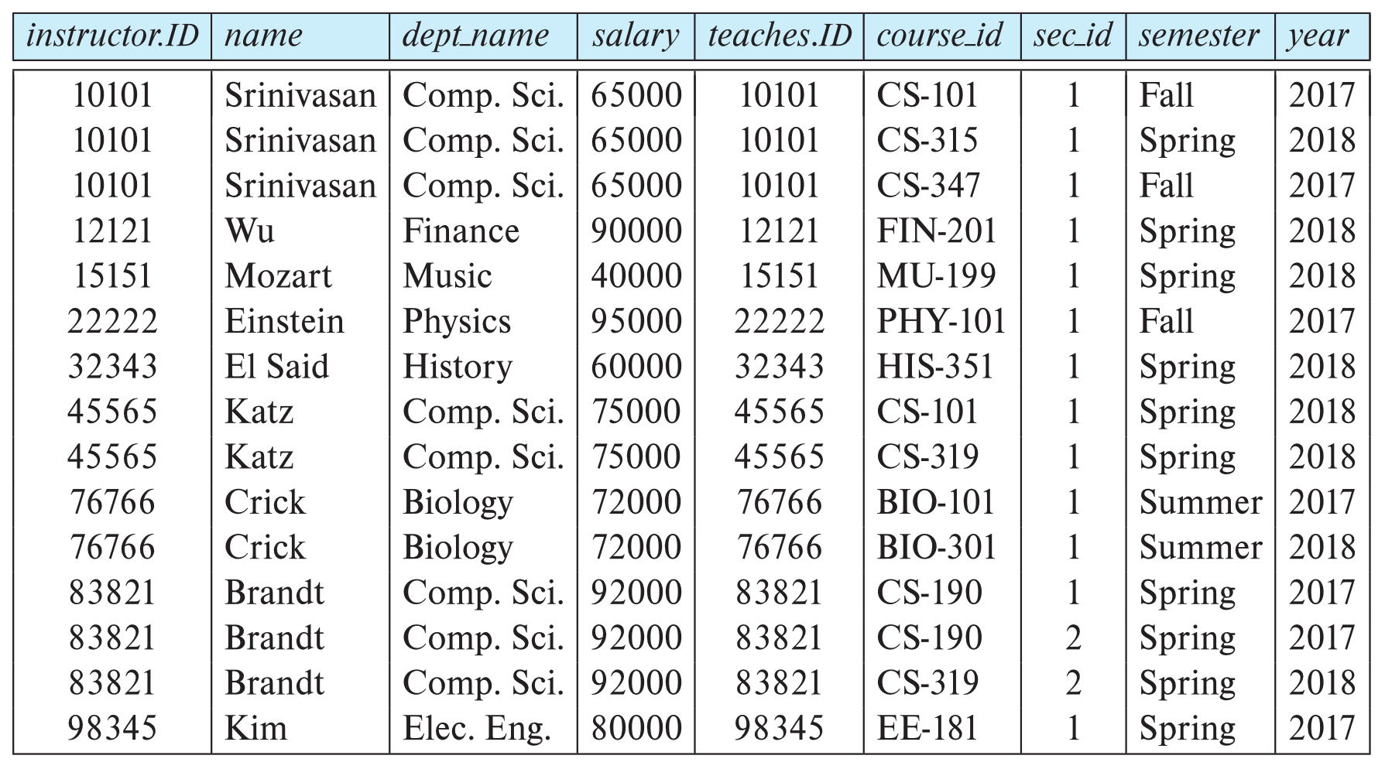
Join Operation (Cont.)
instructor(ID, name, dept_name , salary)
teaches(ID, course_id , sec_id , semester , year);
σ _{instructor.id = teaches.id} (instructor x teaches))

Slide 80
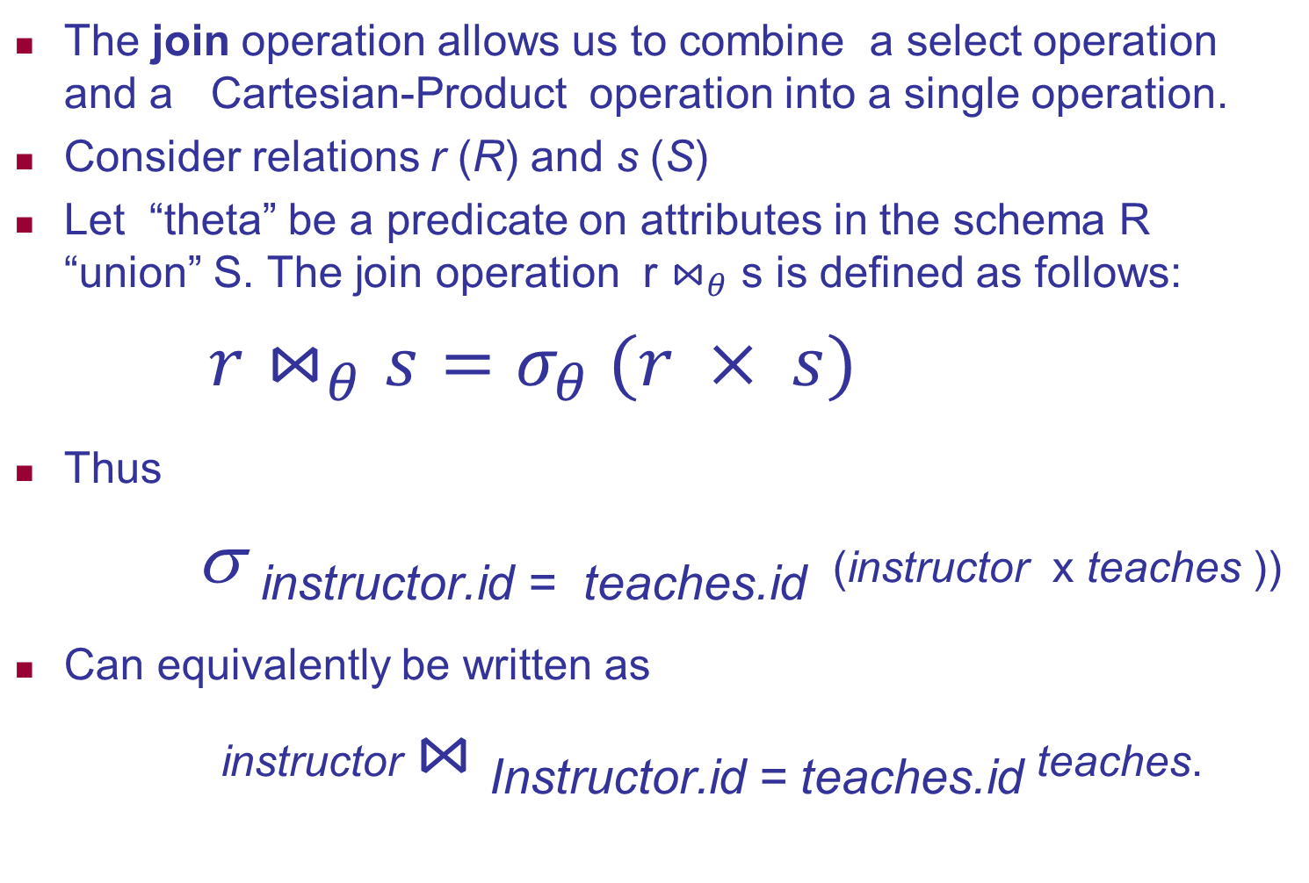
Join Operation (Cont.)
The join operation allows us to combine a select operation and a Cartesian-Product operation into a single operation.
Consider relations r (R) and s (S)
Let “theta” be a predicate on attributes in the schema R “union” S. The join operation r $⋈_{θ}$ s is defined as follows:
$r⋈_{θ}s=σ_{θ} (r × s)$
Thus
σ _{instructor.id = teaches.id} (instructor x teaches ))
Can equivalently be written as
instructor $⋈_{ }$_{Instructor.id = teaches.id} teaches.

Slide 81
Union Operation
The union operation allows us to combine two relations
Notation: r ∪ s
For r ∪ s to be valid.
1. r, s must have the same arity (same number of attributes)
2. The attribute domains must be compatible (example: 2nd
column of r deals with the same type of values as does the
2nd column of s)
Example: to find all courses taught in the Fall 2017 semester, or in the Spring 2018 semester, or in both ∏_{course_id} (σ _{semester=“Fall” Λ year=2017} (section)) ∪ ∏_{course_id} (σ _{semester=“Spring” Λ year=2018} (section))

Slide 82
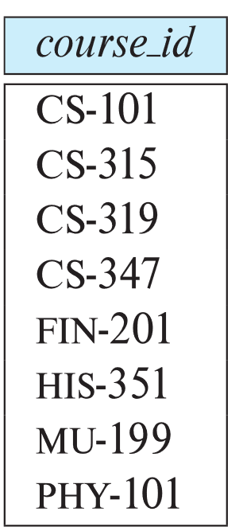
Union Operation (Cont.)
∏_{course_id} (σ _{semester=“Fall” Λ year=2017} (section)) ∪ ∏_{course_id} (σ _{semester=“Spring” Λ year=2018} (section))

Slide 83
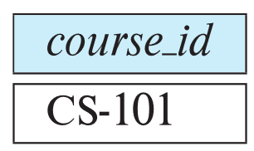
Set-Intersection Operation
The set-intersection operation allows us to find tuples that are in both the input relations.
Notation: r ∩ s
Assume:
r, s have the same arity
attributes of r and s are compatible
Example: Find the set of all courses taught in both the Fall 2017 and the Spring 2018 semesters.
∏_{course_id} (σ _{semester=“Fall” Λ year=2017} (section)) ∩ ∏_{course_id} (σ _{semester=“Spring” Λ year=2018} (section))

Slide 84

Set Difference Operation
The set-difference operation allows us to find tuples that are in one relation but are not in another.
Notation r – s
Set differences must be taken between compatible relations.
r and s must have the same arity
attribute domains of r and s must be compatible
Example: to find all courses taught in the Fall 2017 semester, but not in the Spring 2018 semester ∏_{course_id} (σ _{semester=“Fall” Λ year=2017} (section)) − ∏_{course_id} (σ _{semester=“Spring” Λ year=2018} (section))

Slide 85
The Assignment Operation
It is convenient at times to write a relational-algebra expression by assigning parts of it to temporary relation variables.
The assignment operation is denoted by ← and works like assignment in a programming language.
Example: Find all instructor in the “Physics” and Music department. Physics ← σ _{dept_name=“Physics”} (instructor)
Music ← σ _{dept_name=“Music”} (instructor)
Physics ∪ Music
With the assignment operation, a query can be written as a sequential program consisting of a series of assignments followed by an expression whose value is displayed as the result of the query.

Slide 86
The Rename Operation
The results of relational-algebra expressions do not have a name that we can use to refer to them. The rename operator, ρ , is provided for that purpose
The expression:
ρ_{x} (E)
returns the result of expression E under the name x
Another form of the rename operation:
ρ_{x(A1,A2, .. An)} (E)
REPORT←ρ(_{Ssn, Net_salary, Bonus, Tax})(π_{Ssn, Salary} – Deduction, 2000 *Yrs_service, 0.25 *Salary(EMPLOYEE))
ρ(T(1→instructor.ID,5→teaches.ID), instructor X teaches)
ρ (Tempred, (πsid(σ_{color=‘red’} Boats) ⋈ Reserves)
ρ Tempgreen, (πsid((σ_{color=‘green’} Boats) ⋈ Reserves) π_{sname}((Tempred ∩ Tempgreen) ⋈ Sailors)

Slide 87
Equivalent Queries
There is more than one way to write a query in relational algebra.
Example: Find information about courses taught by instructors in the Physics department with salary greater than 90,000
Query 1
σ _{dept_name=“Physics”} ∧ _{salary > 90,000} (instructor)
Query 2
σ _{dept_name=“Physics”} (σ _{salary > 90.000} (instructor))
The two queries are not identical; they are, however, equivalent -- they give the same result on any database.

Slide 88
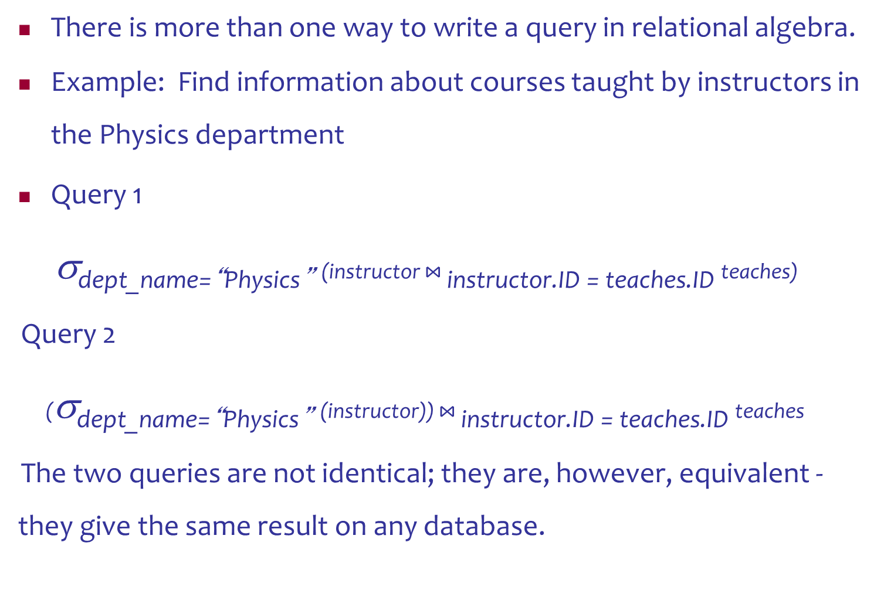
Equivalent Queries
There is more than one way to write a query in relational algebra.
Example: Find information about courses taught by instructors in the Physics department
Query 1
σ_{dept_name=“Physics”} (instructor $⋈_{ }$_{instructor.ID = teaches.ID} teaches)
Query 2
(σ_{dept_name=“Physics”} (instructor)) $⋈_{ }$_{instructor.ID = teaches.ID} teaches
The two queries are not identical; they are, however, equivalent -they give the same result on any database.

Slide 89
Aggregate Functions and
Grouping

Slide 90
Additional Relational Operations: Aggregate Functions and Grouping
A type of request that cannot be expressed in the basic relational algebra is to specify mathematical aggregate functions on collections of values from the database.
Examples of such functions include retrieving the average or total salary of all employees or the total number of employee tuples.
These functions are used in simple statistical queries that summarize information from the database tuples.
Common functions applied to collections of numeric values include
SUM, AVERAGE, MAXIMUM, and MINIMUM.
The COUNT function is used for counting tuples or values.

Slide 91
Aggregate Function Operation
Notation: γ _{X, AGG(Y)}(R)
α_{X, AGG(Y)}(R)
_{X}ℑ_{AGG(Y)} (R)
_{X}ℱ_{AGG(Y)} (R)
group by the attributes in X
aggregate the attribute in Y
SUM, COUNT, AVG (average), MIN, MAX
Output schema: X + an extra (numerical) attribute

Slide 92
Aggregate Function Operation
Use of the Aggregate Functional operation ℱ
ℱ_{MAX Salary} (EMPLOYEE) retrieves the maximum salary value from the EMPLOYEE relation
ℱ_{MIN Salary} (EMPLOYEE) retrieves the minimum Salary value from the EMPLOYEE relation
ℱ_{SUM Salary} (EMPLOYEE) retrieves the sum of the Salary from the EMPLOYEE relation
ℱ_{COUNT SSN, AVERAGE Salary} (EMPLOYEE) computes the count (number) of employees and their average salary
Note: count just counts the number of rows, without removing duplicates
_{<grouping attributes>}ℑ_{<function list>} (R)

Slide 93
Using Grouping with Aggregation
The previous examples all summarized one or more attributes for a set of tuples
Maximum Salary or Count (number of) Ssn
Grouping can be combined with Aggregate Functions
Example: For each department, retrieve the DNO, COUNT SSN, and AVERAGE SALARY
A variation of aggregate operation ℱ allows this:
Grouping attribute placed to left of symbol
Aggregate functions to right of symbol
_{DNO} ℱ_{COUNT SSN, AVERAGE Salary} (EMPLOYEE)
Above operation groups employees by DNO (department number) and computes the count of employees and average salary per department

Slide 94
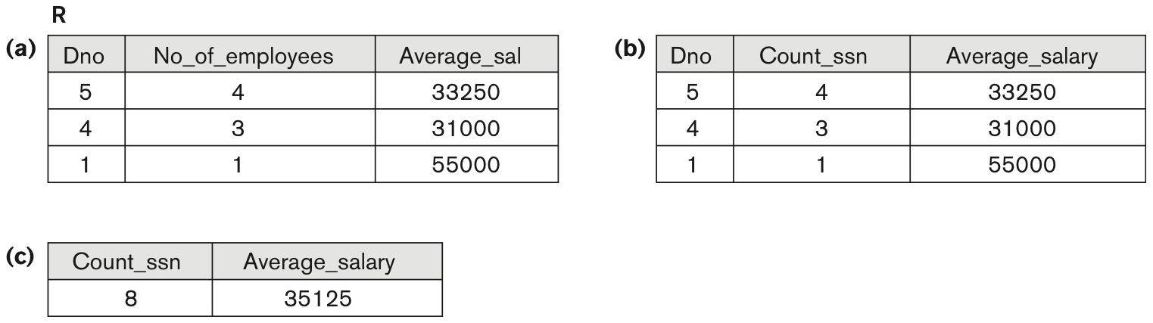
The aggregate function operation.
(a) ρR(Dno, No_of_employees, Average_sal)(_{Dno} ℑ _{COUNT Ssn, AVERAGE Salary} (EMPLOYEE))
(b) _{Dno} ℑ COUNT ssn AVERAGE salary (EMPLOYEE)
(c). ℑ _{COUNT Ssn, AVERAGE Salary}(EMPLOYEE)
no grouping

Slide 95
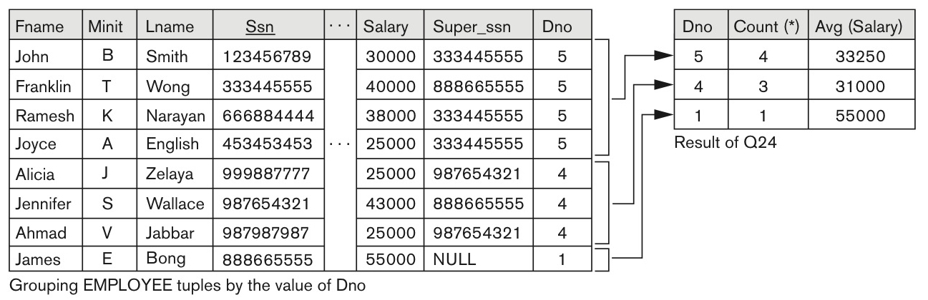
Results of GROUP BY and HAVING (in SQL).
_{Dno} ℑ COUNT ssn AVERAGE salary (EMPLOYEE)
SELECT Dno, COUNT(*), AVG(Salary)
FROM EMPLOYEE
GROUP BY Dno;
continued on next slide

Slide 96
Additional Relational Operations (continued)
Recursive Closure Operations
Another type of operation that, in general, cannot be specified in the basic original relational algebra is recursive closure.
This operation is applied to a recursive relationship.

Slide 97
Recursive Closure Operations
An example of a recursive operation is to retrieve all SUPERVISEES of an EMPLOYEE e at all levels that is,
all EMPLOYEE e₁ directly supervised by e;
all employees e₂ directly supervised by each employee e₁;
all employees e₃ directly supervised by each employee e₂; and so on.
For example, to specify the Ssns of all employees e′ directly supervised—at level one—by the employee e whose name is ‘James Borg’ :
BORG_SSN←πSsn(σFname=‘James’AND Lname=‘Borg’(EMPLOYEE))
SUPERVISION(Ssn1, Ssn2) ←π_{Ssn,Super_ssn}(EMPLOYEE)
RESULT1(Ssn) ←π_{Ssn1}(SUPERVISION ⋈ _{Ssn2=Ssn}BORG_SSN)

Slide 98
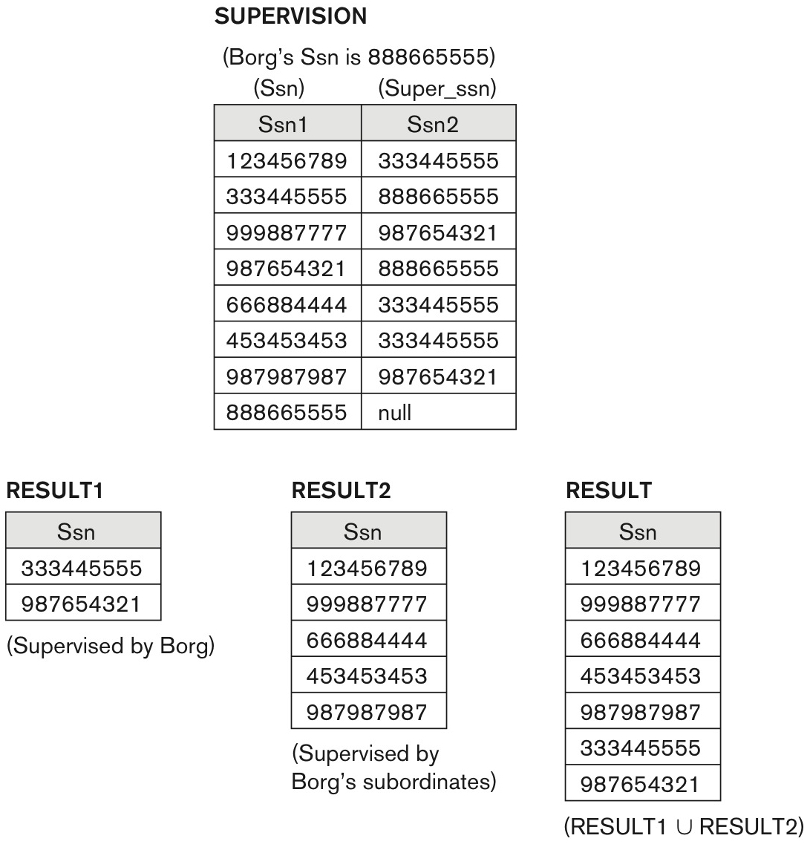
A two-level recursive query.
To retrieve all employees supervised by Borg at level 2 that is, all employees e₂ supervised by some employee e′ who is directly supervised by Borg.
RESULT2(Ssn) ←π_{Ssn1}(SUPERVISIONS ⋈ _{sn2=Ssn}RESULT1)
RESULT←RESULT2 ∪ RESULT1

Slide 99
Query Tree Notation
Query Tree
An internal data structure to represent a query
Standard technique for estimating the work involved in executing the query, the generation of intermediate results, and the optimization of execution.
Algebraic Query Optimization consists of rewriting the query or modifying the query tree into an equivalent tree.

Slide 100
Query Tree Notation
Query Tree
Nodes stand for operations like selection, projection, join, renaming, division, ….
Leaf nodes represent base relations
A tree gives a good visual feel of the complexity of the query and the operations involved
Example
Q2:
SELECT P.Pnumber, P.Dnum, E.Lname, E.Address, E.Bdate FROM PROJECT P, DEPARTMENT D, EMPLOYEE E
WHERE P.Dnum=D.Dnumber AND
D.Mgr_ssn=E.Ssn AND
P.Plocation= ‘Stafford’;

Slide 101
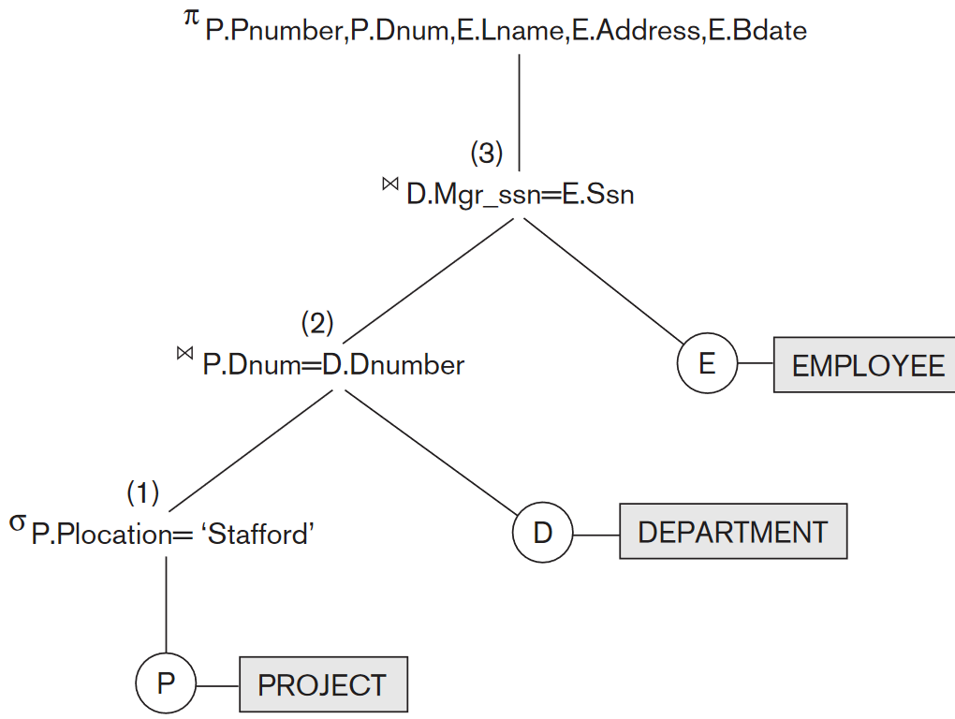

SELECT P.Pnumber, P.Dnum, E.Lname, E.Address, E.Bdate
WHERE
P.Dnum=D.Dnumber
AND D.Mgr_ssn=E.Ssn
AND P.Plocation= ‘Stafford’;
Example of Query Tree
FROM
PROJECT P, DEPARTMENT D, EMPLOYEE E
Notes:
SELECT P.Pnumber, P.Dnum, E.Lname, E.Address, E.Bdate FROM PROJECT P, DEPARTMENT D, EMPLOYEE E
WHERE P.Dnum=D.Dnumber AND D.Mgr_ssn=E.Ssn AND P.Plocation= ‘Stafford’;

Slide 102
Examples of Queries in Relational Algebra

Slide 103
Examples
A report may be required to show
Net Salary = Salary – Deduction,
Bonus = 2000 *Yrs_service, and
Tax = 0.25 *Salary
Then a generalized projection combined with renaming may be used as follows:
REPORT←ρ(_{Ssn, Net_salary, Bonus, Tax})(π_{Ssn, Salary} – Deduction, 2000 *Yrs_service, 0.25 *Salary(EMPLOYEE))

Slide 104
Examples of Queries in Relational Algebra : Procedural Form
Q1: Retrieve the name and address of all employees who work for the ‘Research’ department.
RESEARCH_DEPT ← σ DNAME=’Research’ (DEPARTMENT)
RESEARCH_EMPS ← (RESEARCH_DEPT ⋈_{DNUMBER= DNOEMPLOYEE}EMPLOYEE)
RESULT ← π FNAME, LNAME, ADDRESS (RESEARCH_EMPS)
Q6: Retrieve the names of employees who have no dependents.
ALL_EMPS ← π SSN(EMPLOYEE)
EMPS_WITH_DEPS(SSN) ← π ESSN(DEPENDENT)
EMPS_WITHOUT_DEPS ← (ALL_EMPS - EMPS_WITH_DEPS)
RESULT ← π LNAME, FNAME (EMPS_WITHOUT_DEPS * EMPLOYEE)

Slide 105
Examples of Queries in Relational Algebra: Single expressions
As a single expression, these queries become:
Q1: Retrieve the name and address of all employees who work for the ‘Research’ department.
π _{Fname, Lname, Address} (σ_{Dname}= ‘Research’(DEPARTMENT ⋈_{Dnumber=Dno}(EMPLOYEE))
Q6: Retrieve the names of employees who have no dependents.
π _{Lname, Fname}((π_{Ssn} (EMPLOYEE) − ρ_{Ssn} (π_{Essn} (DEPENDENT))) ∗ EMPLOYEE)

Slide 106
Examples of Queries in Relational Algebra
Retrieve the names of employees who work on all the projects that ‘John Smith’ works on.
SMITH←σ_{Fname=‘John’AND Lname=‘Smith’}(EMPLOYEE)
SMITH_PNOS←π_{Pno}(WORKS_ON ⋈_{Essn=Ssn}SMITH)
SSN_PNOS←π_{Essn, Pno}(WORKS_ON)
SSNS(Ssn) ←SSN_PNOS ÷ SMITH_PNOS
RESULT←π_{Fname, Lname}(SSNS * EMPLOYEE)

Slide 107
Examples of Queries in Relational Algebra
Query 1. Retrieve the name and address of all employees who work for the ‘Research’ department.
RESEARCH_DEPT←σ_{Dname=‘Research’}(DEPARTMENT)
RESEARCH_EMPS← (RESEARCH_DEPT ⋈ _{Dnumber=Dno}EMPLOYEE)
RESULT←π_{Fname, Lname, Address}(RESEARCH_EMPS)
As a single in-line expression, this query becomes:
π_{Fname, Lname, Address}(σ_{Dname=‘Research’}(DEPARTMENT⋈ _{Dnumber=Dno}(EMPLOYEE))

Slide 108
Examples of Queries in Relational Algebra
Query 2. For every project located in ‘Stafford’, list the project number, the controlling department number, and the department manager’s last name, address, and birth date.
STAFFORD_PROJS←σ_{Plocation=‘Stafford’}(PROJECT)
CONTR_DEPTS← (STAFFORD_PROJS⋈_{Dnum=Dnumber}DEPARTMENT) PROJ_DEPT_MGRS← (CONTR_DEPTS ⋈ _{Mgr_ssn=Ssn}EMPLOYEE)
RESULT←πPnumber, Dnum, Lname, Address, Bdate(PROJ_DEPT_MGRS)

Slide 109
Examples of Queries in Relational Algebra
Query 3. Find the names of employees who work on all the projects controlled by department number 5.
DEPT5_PROJS←ρ_{(Pno)}(π_{Pnumber}(σ_{Dnum=5}(PROJECT)))
EMP_PROJ←ρ_{(Ssn, Pno)}(π_{Essn, Pno}(WORKS_ON)) RESULT_EMP_SSNS←EMP_PROJ ÷ DEPT5_PROJS
RESULT←π_{Lname, Fname}(RESULT_EMP_SSNS *EMPLOYEE)

Slide 110
Examples of Queries in Relational Algebra
Query 4. Make a list of project numbers for projects that involve an employee whose last name is ‘Smith’, either as a worker or as a manager of the department that controls the project.
SMITHS(Essn) ←π_{Ssn} (σ_{Lname=‘Smith’}(EMPLOYEE)) SMITH_WORKER_PROJS←π_{Pno}(WORKS_ON * SMITHS)
MGRS←π_{Lname, Dnumber}(EMPLOYEE ⋈ _{Ssn=Mgr_ssn}DEPARTMENT) SMITH_MANAGED_DEPTS(Dnum) ←π_{Dnumber} (σ_{Lname=‘Smith’}(MGRS)) SMITH_MGR_PROJS(Pno) ←π_{Pnumber}(SMITH_MANAGED_DEPTS *PROJECT)
RESULT ← (SMITH_WORKER_PROJS ∪ SMITH_MGR_PROJS)
As a single in-line expression, this query becomes:
π_{Pno} (WORKS_ONEssn=Ssn (π_{Ssn} (σ_{Lname=‘Smith’}(EMPLOYEE))) ∪ π_{Pno}((π_{Dnumber} (σ_{Lname=‘Smith’}(π_{Lname, Dnumber}(EMPLOYEE))) ⋈ _{Ssn=Mgr_ssn}DEPARTMENT)) ⋈ Dnumber=DnumPROJECT)

Slide 111
Examples of Queries in Relational Algebra
Query 5. List the names of all employees with two or more dependents.
Strictly speaking, this query cannot be done in the basic (original) relational algebra. We have to use the AGGREGATE FUNCTION operation with the COUNT aggregate function. We assume that dependents of the same employee have distinct Dependent_name values.
T1(Ssn, No_of_dependents)←Essnℑ_{COUNT} _{Dependent_name}(DEPENDENT)
T2 ←σ_{No_of_dependents>2}(T1)
RESULT←π_{Lname, Fname}(T2 *EMPLOYEE)

Slide 112
Examples of Queries in Relational Algebra
Query 6. Retrieve the names of employees who have no dependents.
This is an example of the type of query that uses the MINUS (SET DIFFERENCE) operation.
ALL_EMPS←π_{Ssn}(EMPLOYEE)
EMPS_WITH_DEPS(Ssn) ←π_{Essn}(DEPENDENT)
EMPS_WITHOUT_DEPS← (ALL_EMPS – EMPS_WITH_DEPS)
RESULT←π_{Lname, Fname}(EMPS_WITHOUT_DEPS *EMPLOYEE)
As a single in-line expression, this query becomes:
π_{Lname, Fname}((π_{Ssn}(EMPLOYEE) – ρ_{Ssn}(π_{Essn}(DEPENDENT))) *EMPLOYEE)

Slide 113
Examples of Queries in Relational Algebra
Query 7. List the names of managers who have at least one dependent.
MGRS(Ssn) ← π_{Mgr_ssn}(DEPARTMENT)
EMPS_WITH_DEPS(Ssn) ← π_{Essn}(DEPENDENT)
MGRS_WITH_DEPS ← (MGRS ∩ EMPS_WITH_DEPS)
RESULT ← π_{Lname, Fname}(MGRS_WITH_DEPS * EMPLOYEE)

